Slide 1


How to write SYNTHESIBLE VERILOG ?
https://www.youtube.com/watch?v=lPamtRAVVn8&list=PLbVWalfEstJ09kQc1wPrpJ0zKFMSI1CzM&index=9
https://www.youtube.com/playlist?list=PLAC_jmBddcjTPEh1UV_ojRJmsx2D9sQXH (VERY GOOD)
https://www.youtube.com/watch?v=RBySzoe6i9M&list=PLJ5C_6qdAvBELELTSPgzYkQg3HgclQh-5&index=28 (NPTEL)
https://www.eng.auburn.edu/~nelsovp/courses/elec4200/VHDL/Verilog_Overview_4200.pdf (REVISION)
MADE BY Rithan Btech final year
NIT TRICHY

Slide 2
The synthesis is constraint driven and technology independent !!
Constraints
■ The area and timing of your circuit are mainly determined by your circuit architecture and coding style
■ There is always a trade-off between the circuit timing and area
■ In fact, a super tight timing constraint may be worked while synthesis, but failed in the Place & Route (P&R) procedure
MADE BY Rithan athith,
Btech final year
NIT TRICHY

Slide 3
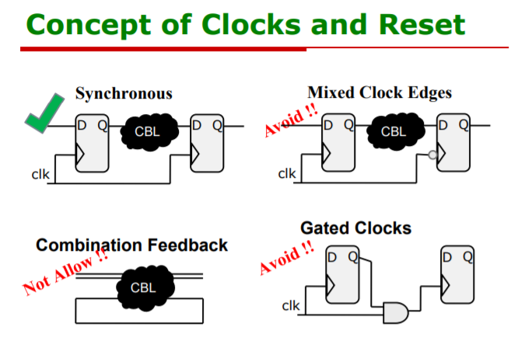

Slide 4
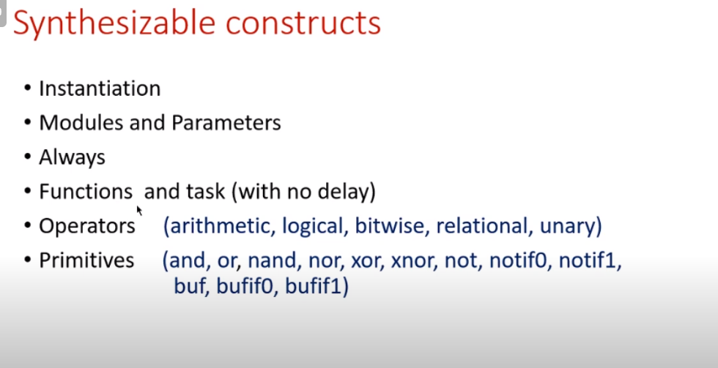

Slide 5
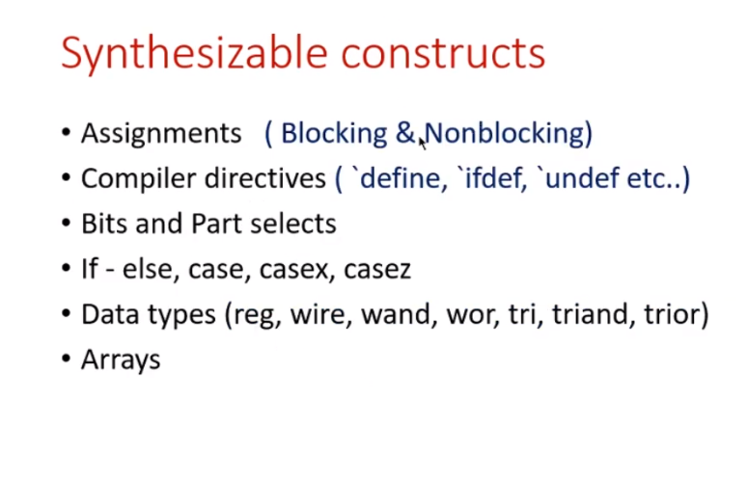

Slide 6
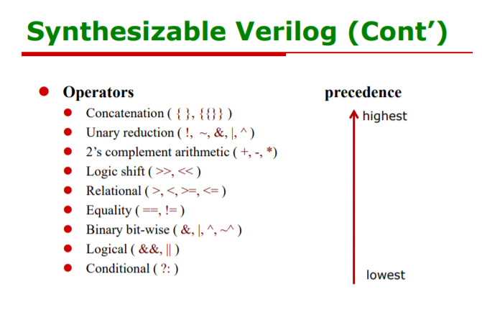

Slide 7
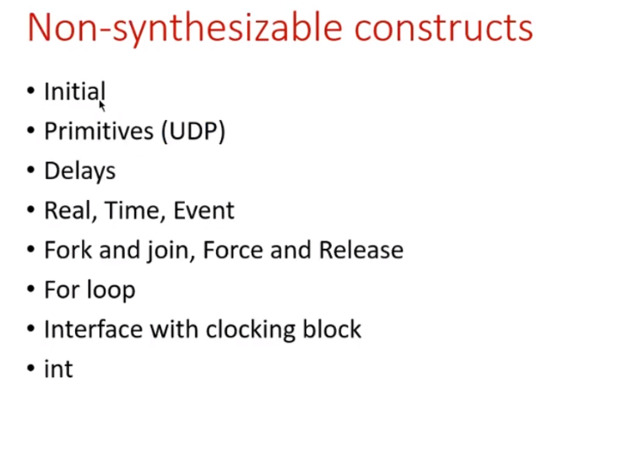

Slide 8
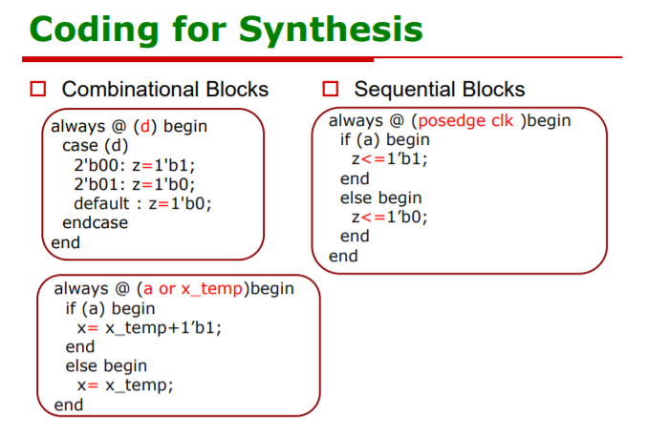

Slide 9
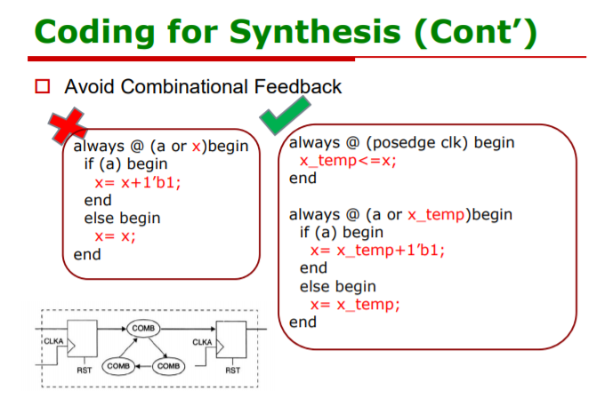

Slide 10
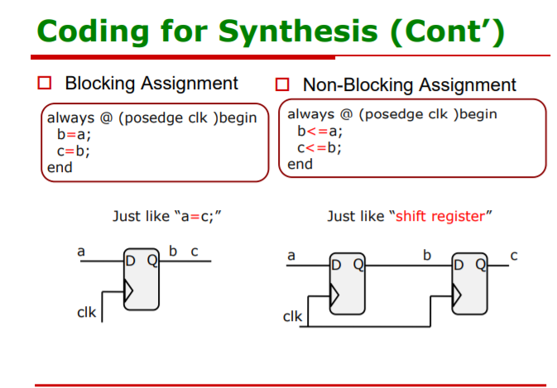

Slide 11
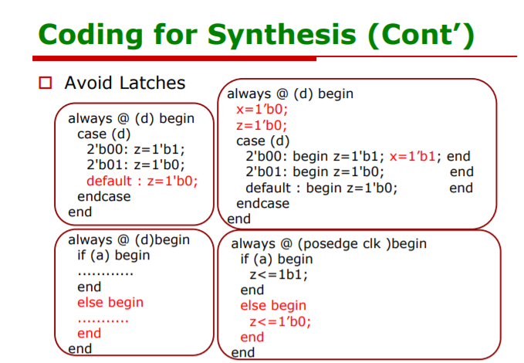

Slide 12
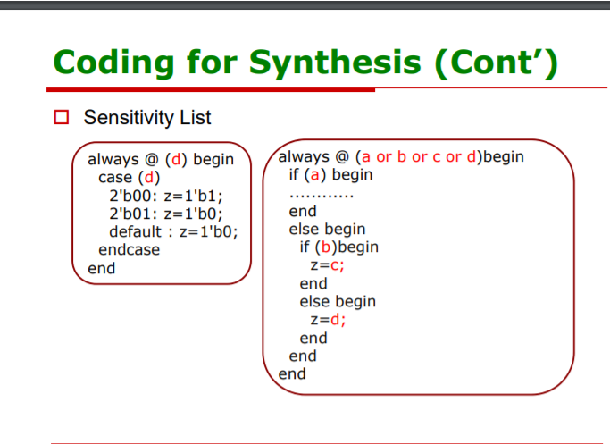

Slide 13
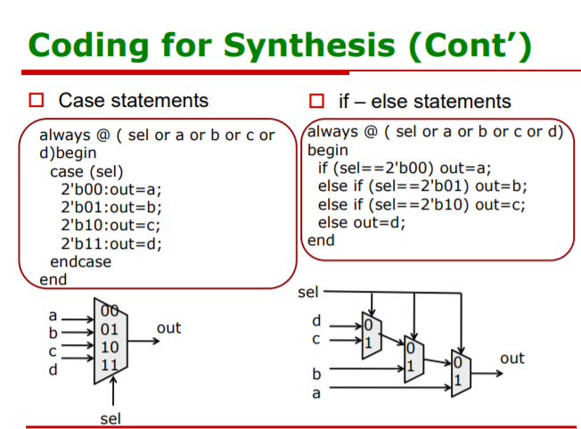

Slide 14
NON SYNTHESIBLE CONSTRUCTS
Either non-synthesizable or incorrect after synthesis
initial block is forbidden (non-synthesizable)
Multiple assignments (multiple driving sources)
Mixing both blocking and non-blocking assignment in same always block.

Slide 15
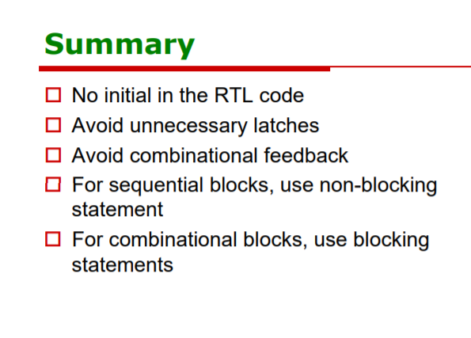

Slide 16
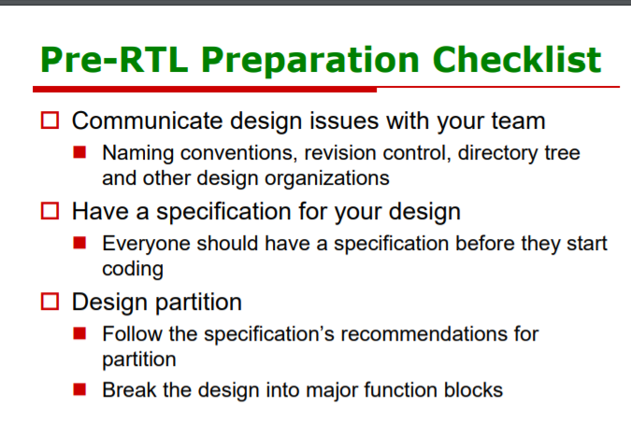
Rtl design

Slide 17
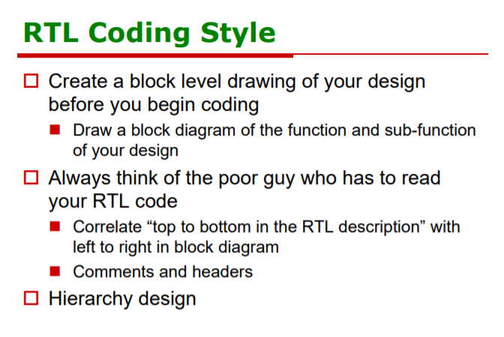

Slide 18
Include the header for bibliography and author &project details
Indentation
Give proper name for variables like rst_n for active low signals
Use Functions or Tasks Instead of repeating the same sections of code

Slide 19
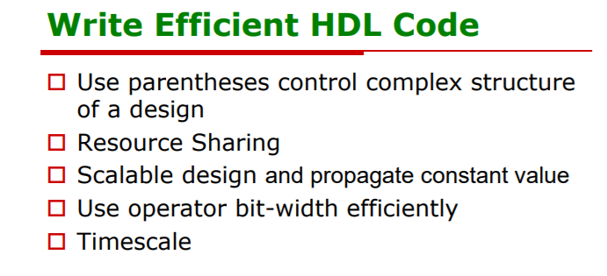

Slide 20
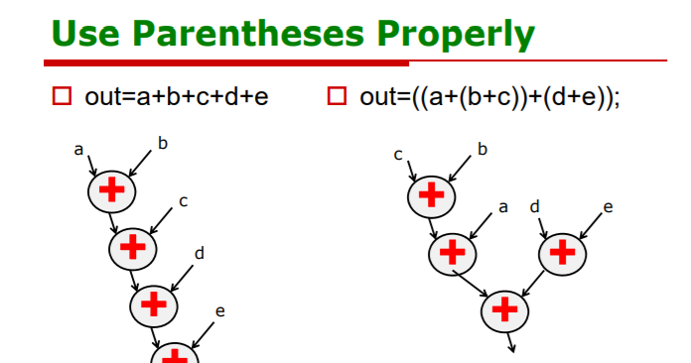

Slide 21
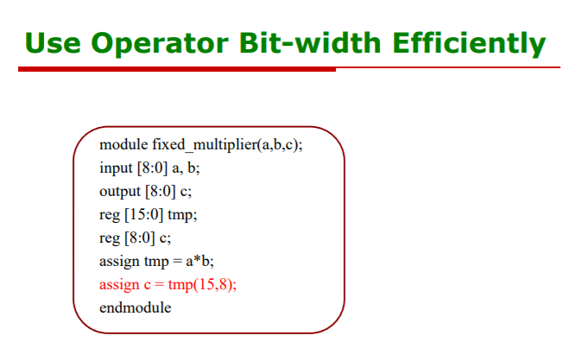

Slide 22
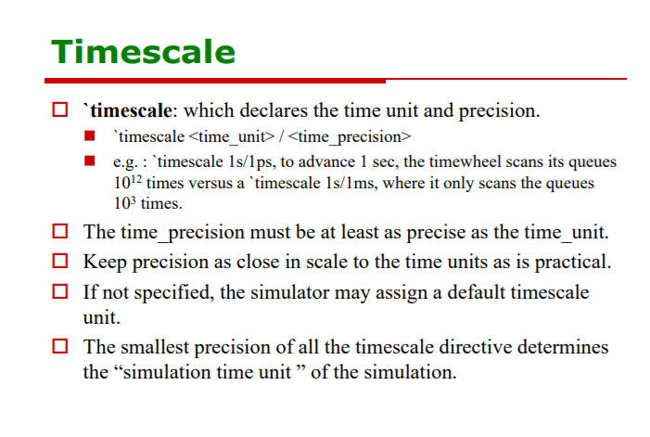

Slide 23
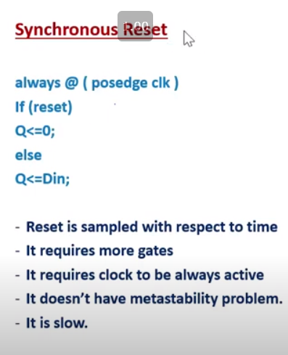
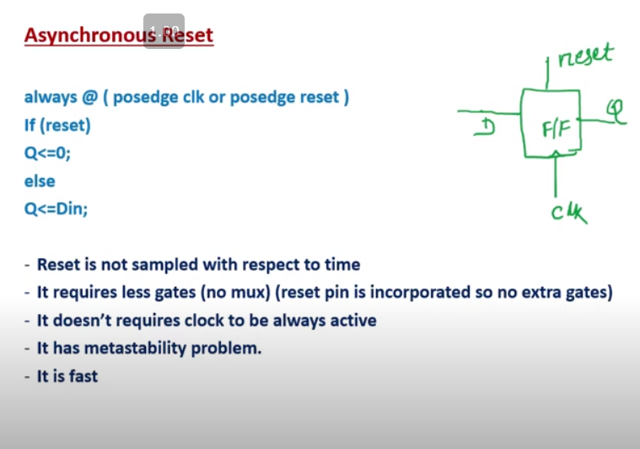

Slide 24
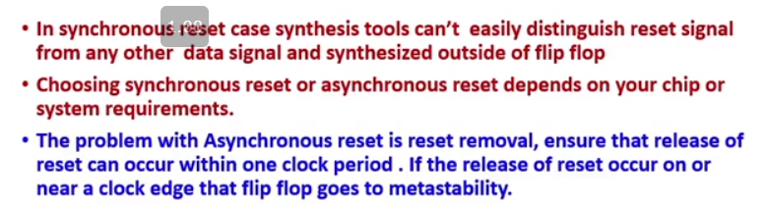
Synchronous vs asynchronous reset https://www.youtube.com/watch?v=uB4s1X6nsz8&list=PLAC_jmBddcjTPEh1UV_ojRJmsx2D9sQXH&index=20
Synchronous reset- more gates (mux) , slow, more area but main adv is there is NO METASTABILITY
Asynchronous reset- less gates (no mux) , fast, less area but there is METASTABILITY

Slide 25
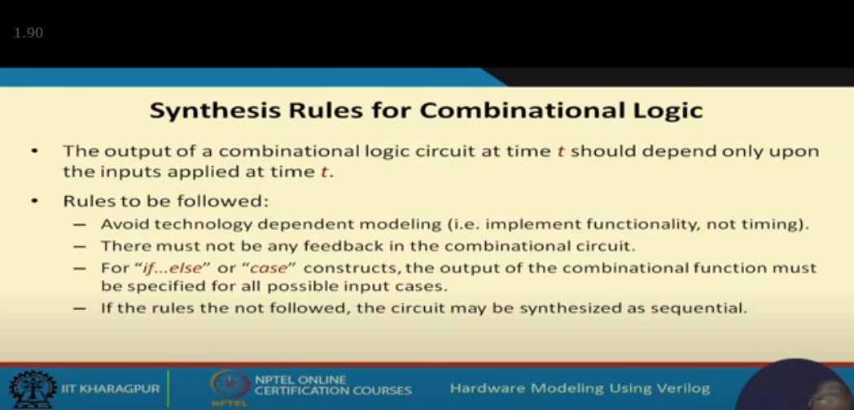
Combinational design

Slide 26
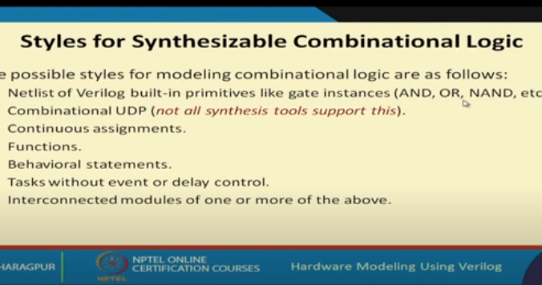

Slide 27
Combinational logic – don’t bring feedback
In case statement or if…else , include all possible input cases to avoid creation of latch for unknown states by synthesis tools
Always block for modelling combinational logic .
Gate /structural modelling
Behaviour modelling
Data flow modelling
Avoid UDP
All the input in procedural block (always block) must be mentioned in sensitivity list to avoid creation of latch for unknown states by synthesis tools .

Slide 28
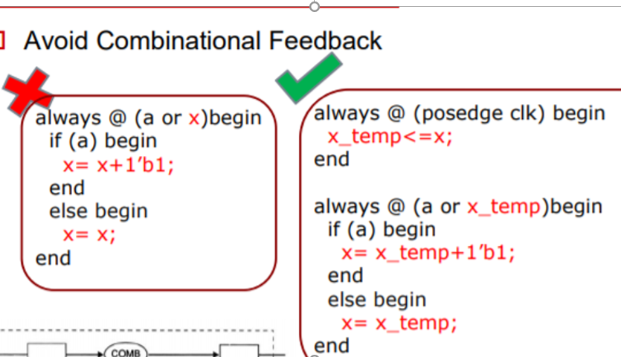
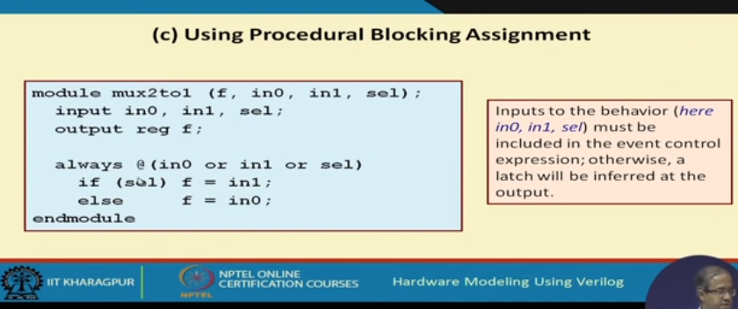

Slide 29
function and task
Function will return only one o/p and generally used with assign statement .
Task will return one or more than one o/p
Task can include delay in it .(non – zero simulation time ).
Function and task are synthesible

Slide 30
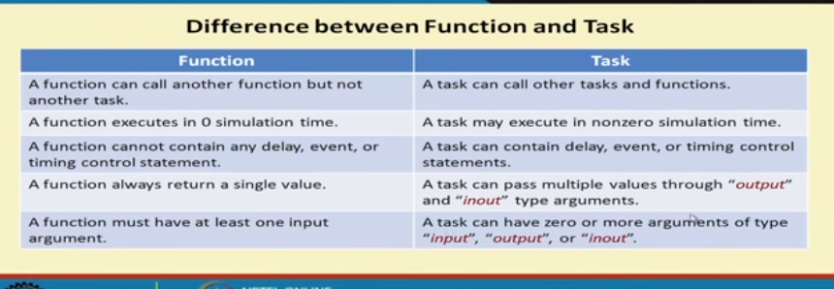

Slide 31
For loop
No of iteration must be fixed
Data dependency loop are not synthesible
The below eg: must be avoided
n= and (a,b,c);
for (i=0, i<n, i++)
---------------
-------------

Slide 32
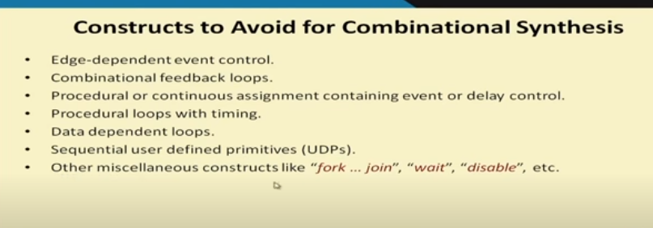

Slide 33
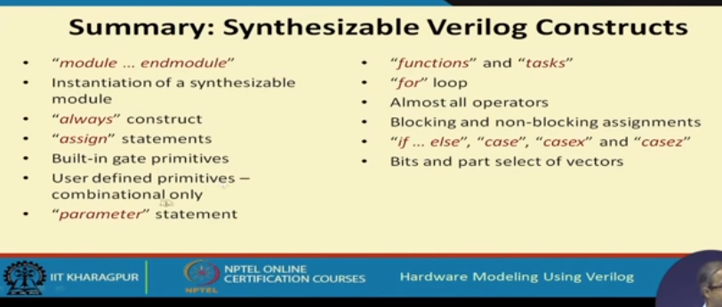

Slide 34
